Slide 1
Privacy Protection and Intrusion Avoidance for Cloudlet-based Medical Data Sharing
- Shradha Biyani

Slide 2
Contents
Introduction
Problem Definition
Existing system
Proposed system
Methodology
System architecture
Implementation
Results and discussion
Conclusion
References

Slide 3
Introduction
A cloudlet is a mobility-enhanced small-scale cloud data center that is located at the edge of the internet.
The word “cloud” often refers to the internet, more precisely to some datacenter full of servers that is connected to the internet.
Cloud-assisted healthcare big data computing becomes critical to meet user’s ever growing demands on health consultation.

Slide 4
Sharing medical data on the social network is beneficial to both patients and doctors, the sensitive data might be leaked or stolen.
The sharing medical data causes privacy and security problems without efficient protection for the shared data.

Slide 5
Problem Definition
Sharing medical data on the social network is favourable to both patients and doctors, the sensitive data might be leaked or stolen.
There is privacy problem during the data sharing in the cloudlet.
There were malicious attacks for the health care system, this leads to protection problems.

Slide 6
Existing system
Traditional work suggested the combination of social networks and healthcare service .
The storage problem of healthcare data in a cloud environment .
MRSE (multi keyword ranked search over encrypted data in cloud computing)privacy protection system was presented.

Slide 7
Disadvantages
The storage problem of medical data was found in the cloud environment.
The security problem was found during the delivery of medical data to the cloud and causes the communication energy consumption.
There was no protection for the data in the health care system from the malicious attack.

Slide 8
Proposed system
During data transmissions to the cloudlet, the NTRU is used for data protection.
To share data in the cloudlet, the trust model is build up by using the user’s similarity and reputation.
The encryption mechanism is used to protect the data in remote cloud of different kinds respectively.
The healthcare system is protected from the malicious attacks by the collaborative IDS based on cloudlet mesh.

Slide 9
Advantages
The proposed system provides for a quick and efficient retrieval of information.
The level of accuracy in proposed system will be higher.
To share data or not, the trust model is used to measure the user’s trust level.
For privacy-preserving of remote cloud data, the data stored in the remote cloud is partitioned and encrypt the data in different ways.

Slide 10
Methodology
Client data encryption
Data sharing over cloud
Remote cloud data privacy protection
Collaborative IDS based on cloud

Slide 11
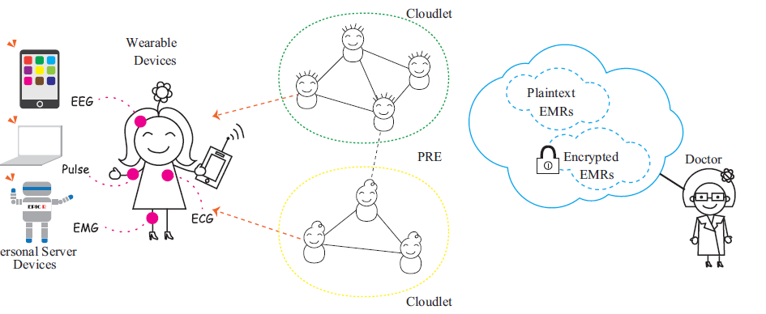
System Architecture

Slide 12
IMPLEMENTATION
MODULES
Cloud Service Provider
Patient
Doctor
Intruder

Slide 13
Cloud Service Provider:
In this cloud service provider module cloud will register and login with valid user name and password.
If authentication is successful cloud can add doctors and send user name and password to doctors registered mail id.
Cloud can view information of registered patients along with data uploaded by patients in encrypted format.
Patient:
In this module patient will register with application and login with user name and password.
Patient can view his profile and encrypt personal data which can be viewed by cloud provider.

Slide 14
Doctor:
In doctor module doctor can check his registered mail id for username and password and login with those details.
Doctor can view patients queries and response to patient
Intruder:
Intruder is a module designed to check malicious activities by un authorized user who don’t have access to data but what to view data.
In this case when intruder views data message is sent to actual user who owns data.

Slide 15
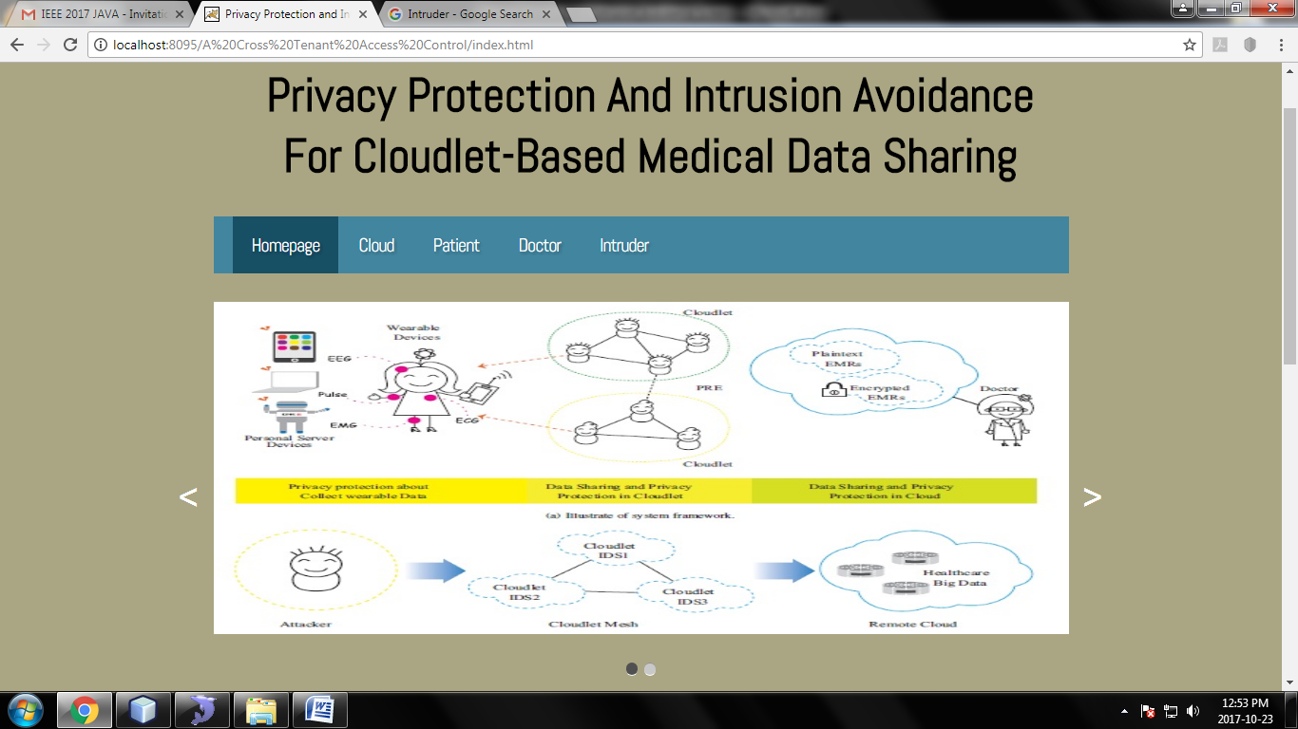
Results and Discussion
Snapshot 1:Home page

Slide 16
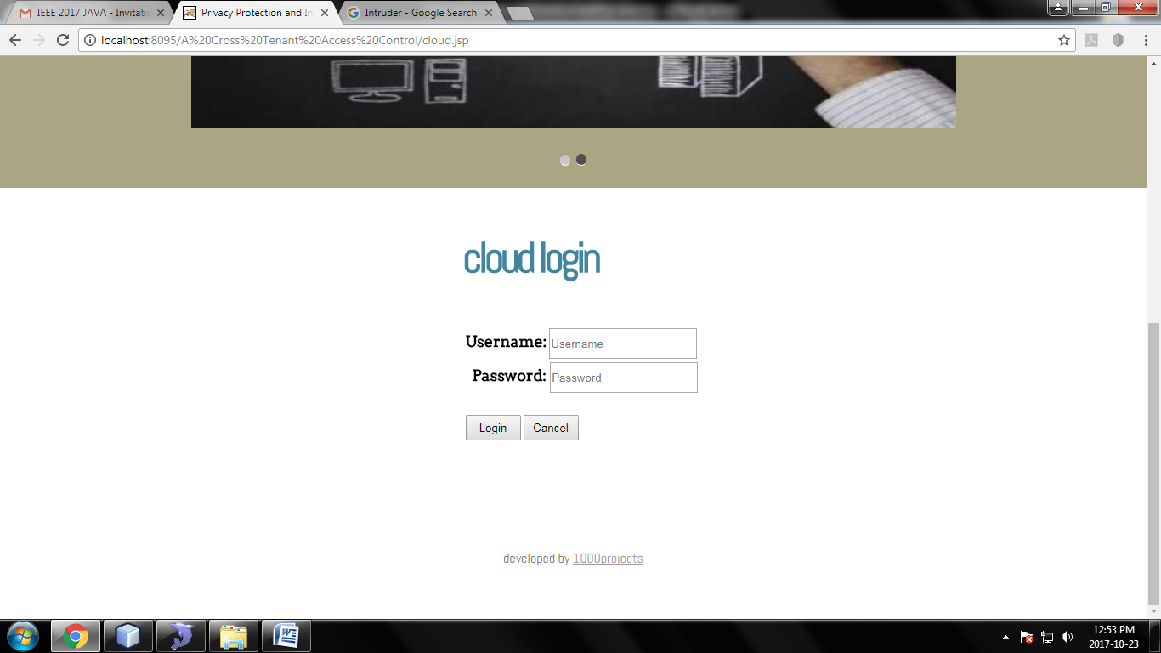
Snapshot 2:login page

Slide 17
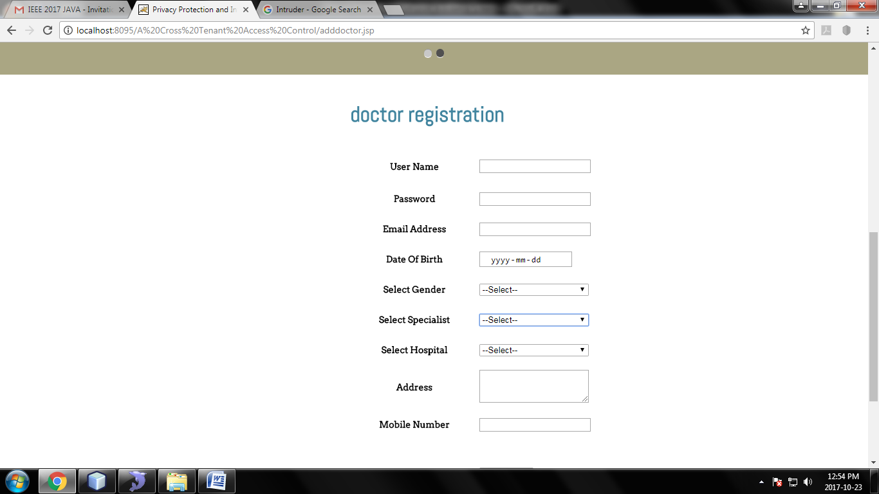
Snapshot 3:Doctor registration

Slide 18
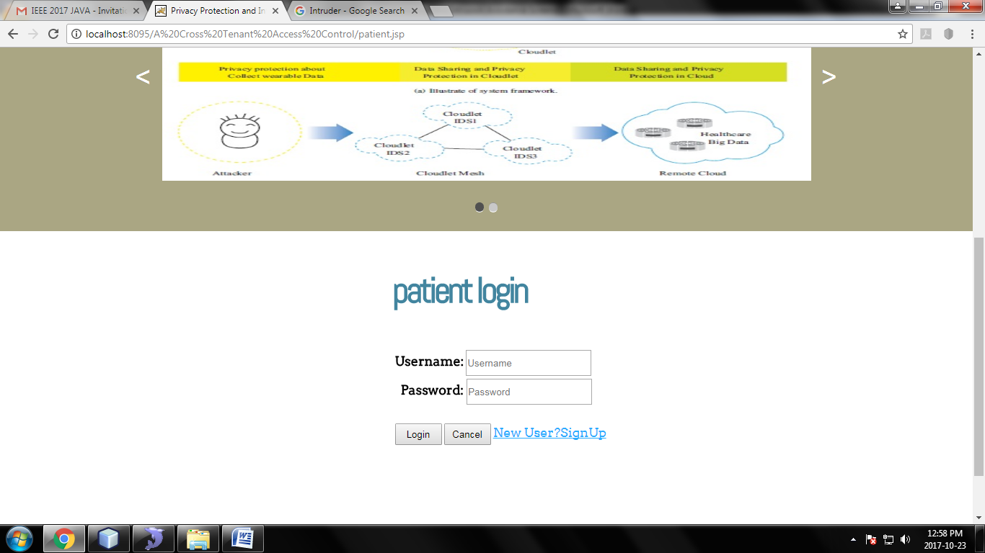
Snapshot 4:Patient login page

Slide 19
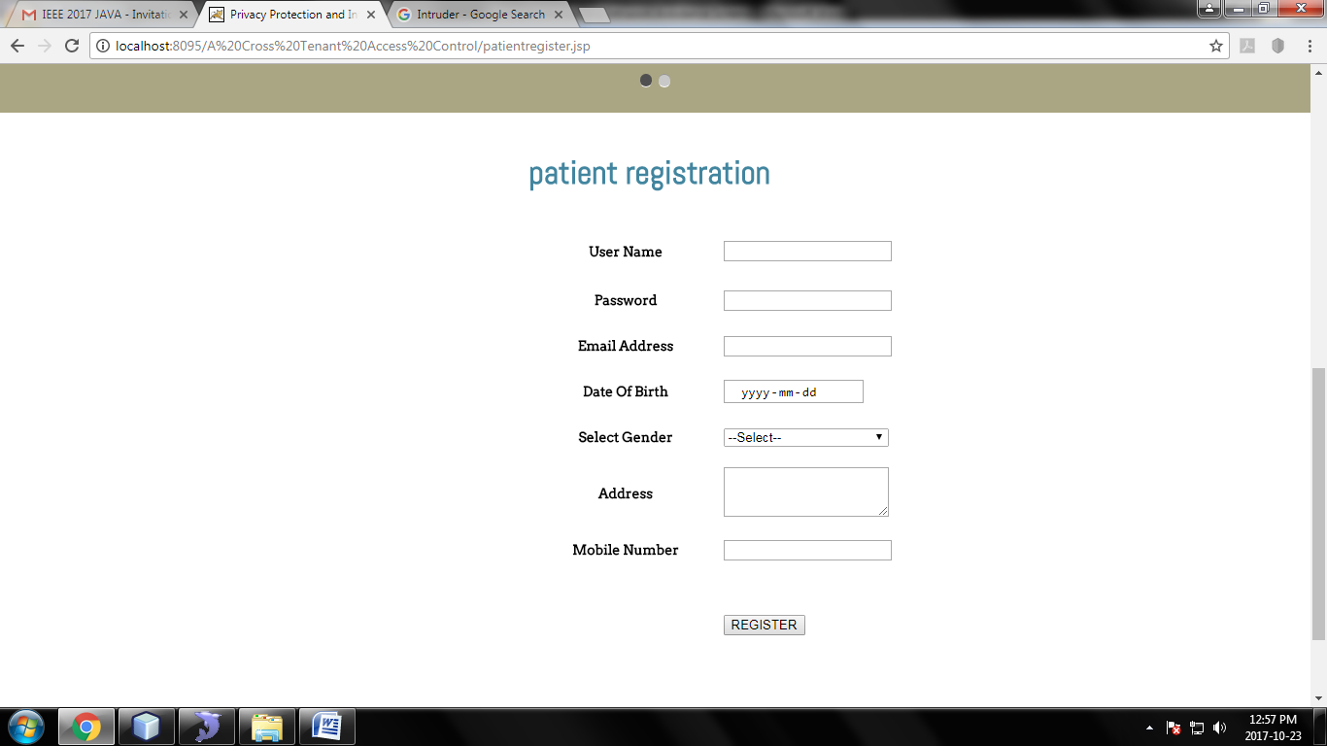
Snapshot 5:Patient registeration

Slide 20
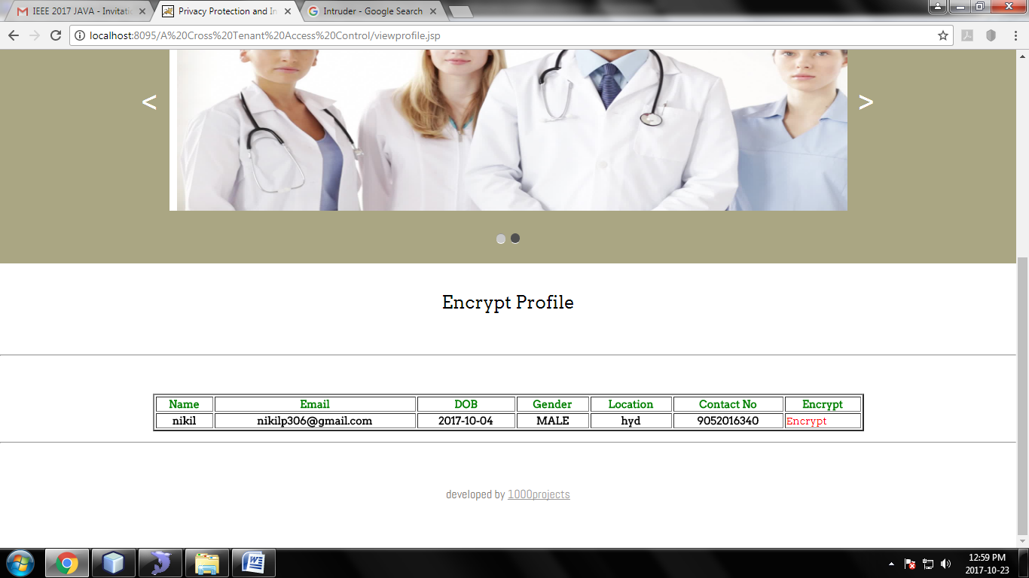
Snapshot 6:Veiw Patient Profile

Slide 21
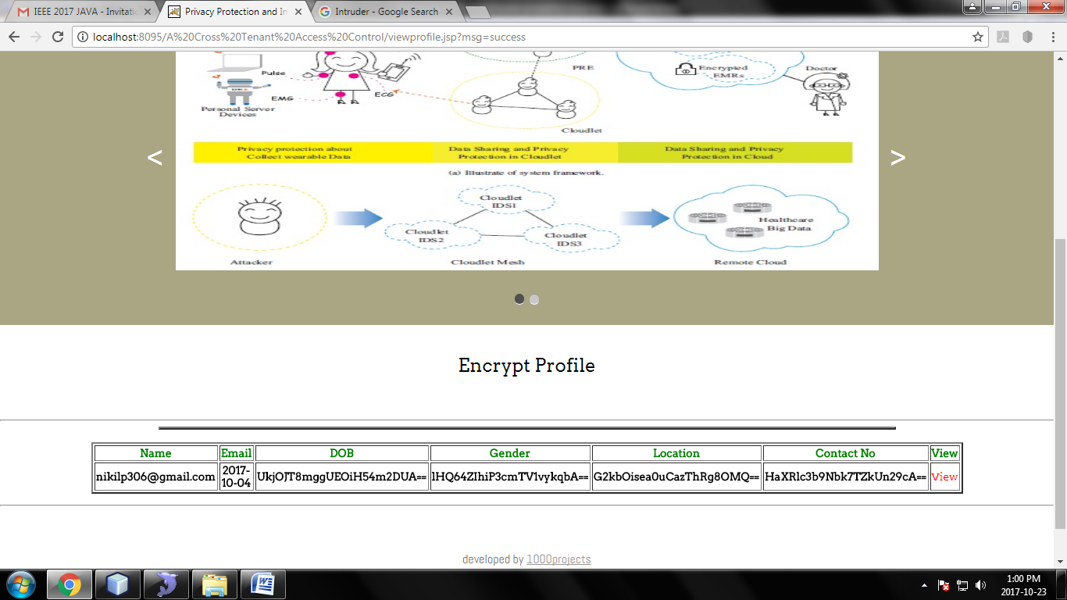
Snapshot 7:View encrypt profile

Slide 22
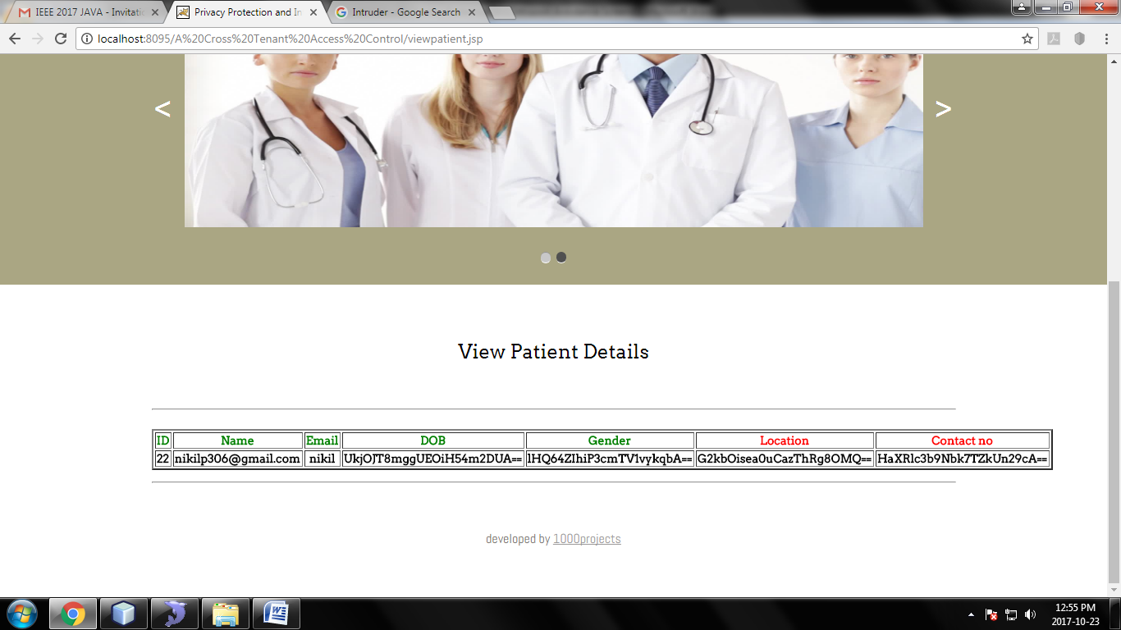
Snapshot 8:View patient details after encryption

Slide 23
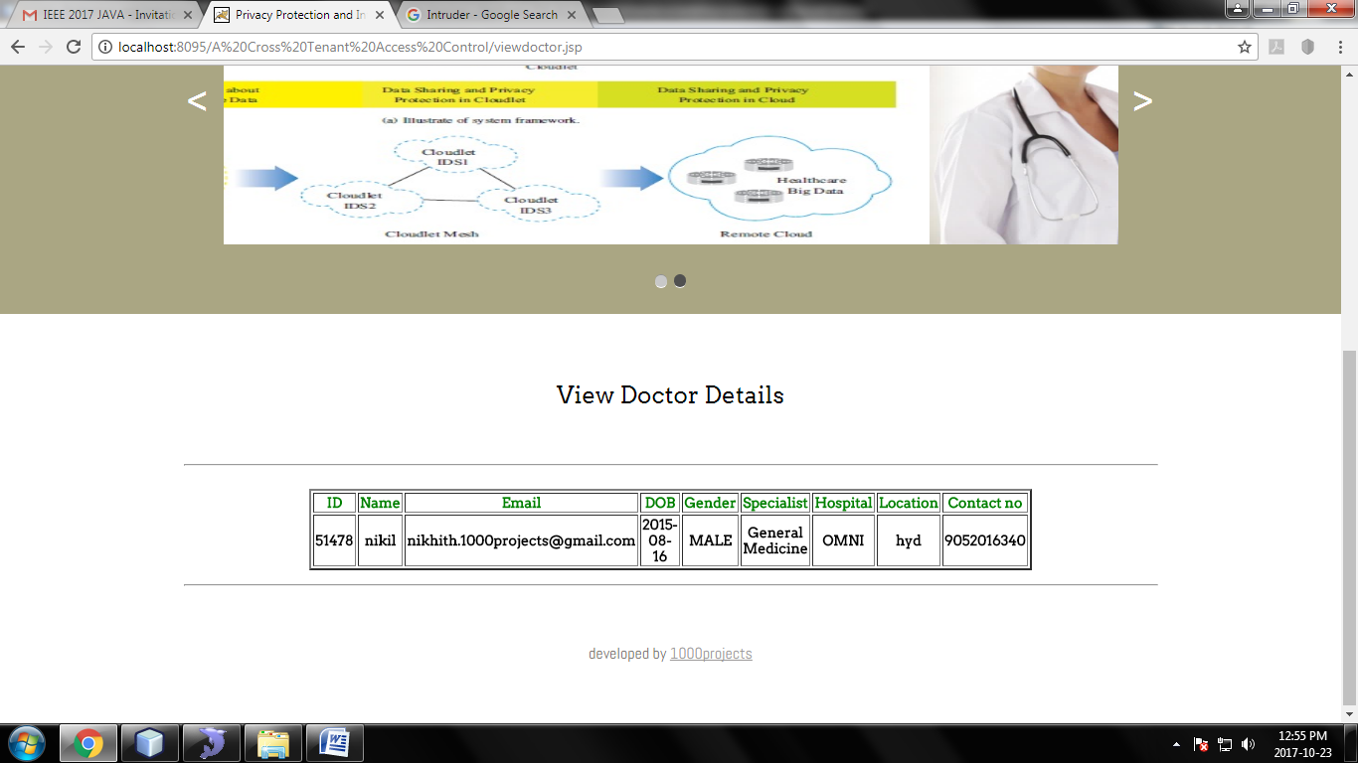
Snapshot 9:Doctor details

Slide 24
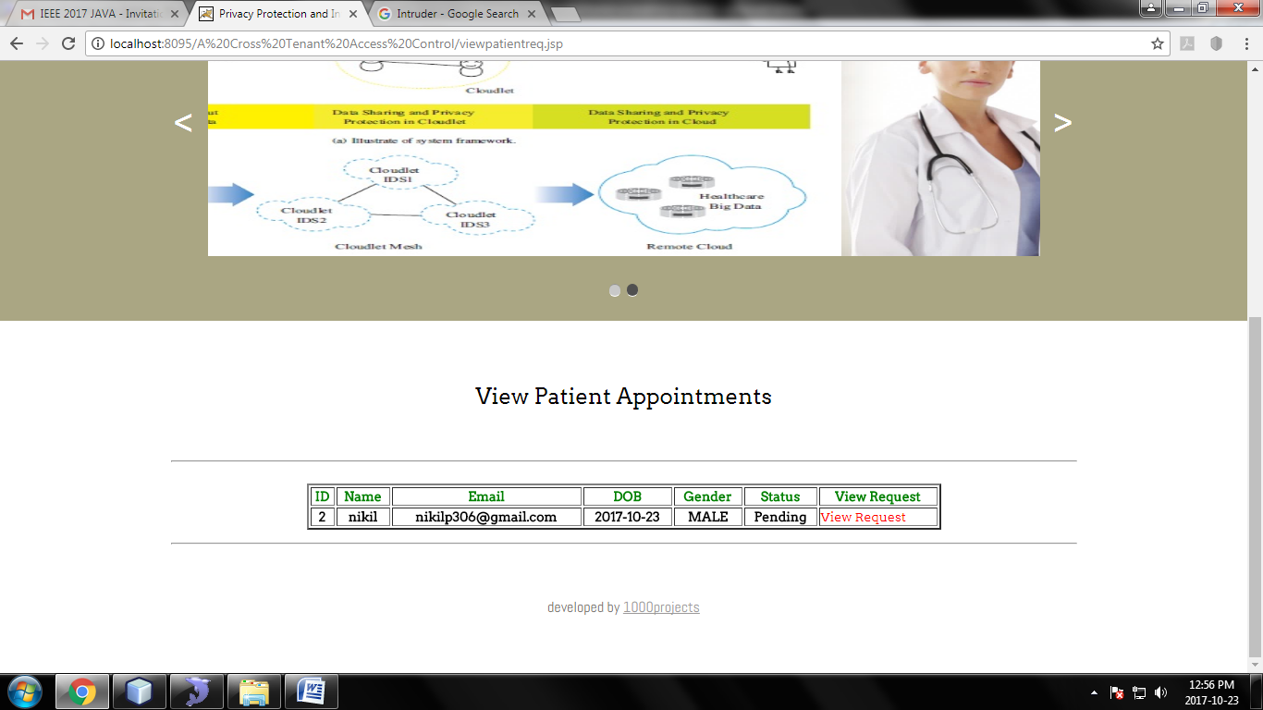
Snapshot 10:View patient request

Slide 25
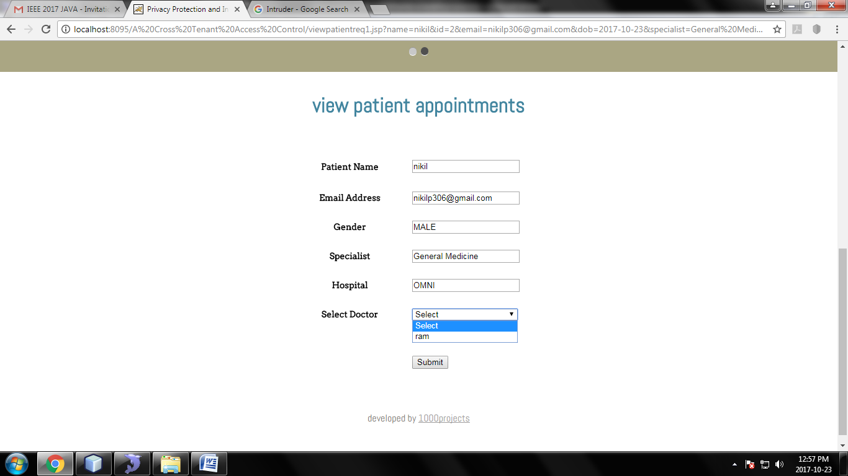
Snapshot 11:View patient appointment

Slide 26
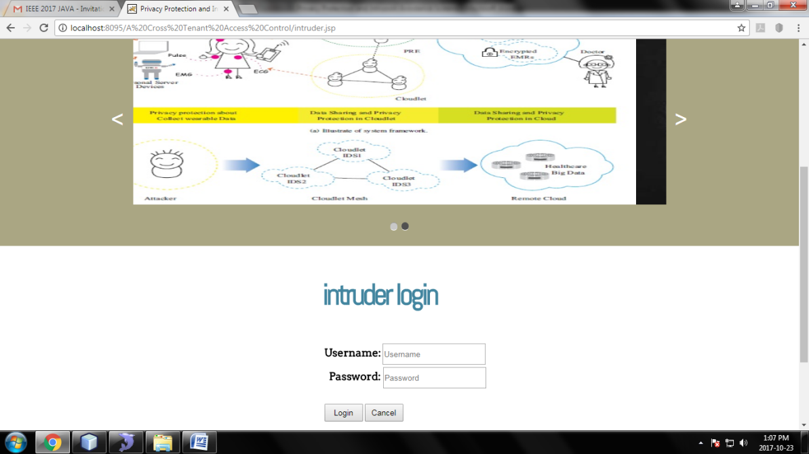
Snapshot 12:Intruder login

Slide 27
CONCLUSION
Firstly, the wearable devices are used to collect users’ data, and in order to protect users privacy, the author used Number theory research unit
( NTRU) mechanism.
Secondly, for the purpose of sharing data in the cloudlet, author used trust model to measure users’ trust level to judge whether to share data or not.
Thirdly, for privacy-preserving of remote cloud data, author partitioned the data stored in the remote cloud and encrypt the data in different ways.
Finally, author proposed collaborative Intrusion Detection System (IDS) based on cloudlet mesh to protect the whole systems.

Slide 28
REFERENCES
[1] K. Hung, Y. Zhang, and B. Tai, “Wearable medical devices for telehome healthcare,” in Engineering in Medicine and Biology Society, 2004. IEMBS’04.26th Annual International Conference of the IEEE, vol. 2. IEEE, 2004, pp. 5384–5387.
[2] R. Zhang and L. Liu, “Security models and requirements for healthcare application clouds,” in Cloud Computing (CLOUD), 2010 IEEE 3rd International Conference on. IEEE, 2010, pp. 268–275.

Slide 29
[3] C. Zhang, J. Sun, X. Zhu, and Y. Fang, “Privacy and security for online social networks: challenges and opportunities,” Network, IEEE, vol. 24, no. 4, pp. 13–18, 2010.
[4] N. Cao, C. Wang, M. Li, K. Ren, and W. Lou, “Privacy-preserving multi-keyword ranked search over encrypted cloud data,” Parallel and Distributed Systems, IEEE Transactions on, vol. 25, no. 1, pp. 222–233, 2014.

Slide 30
THANK YOU

